Slide 1
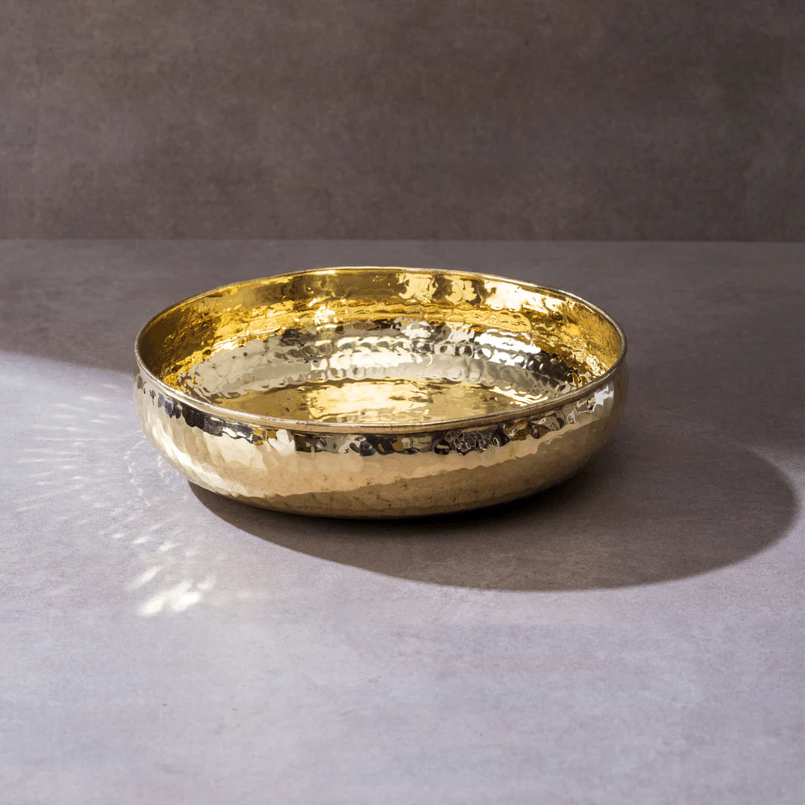
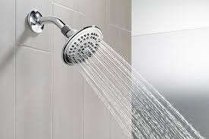
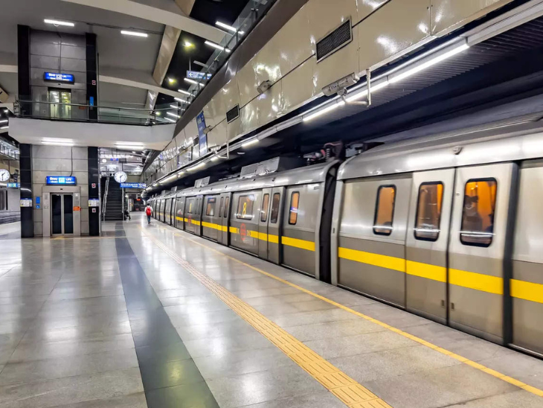
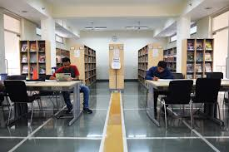
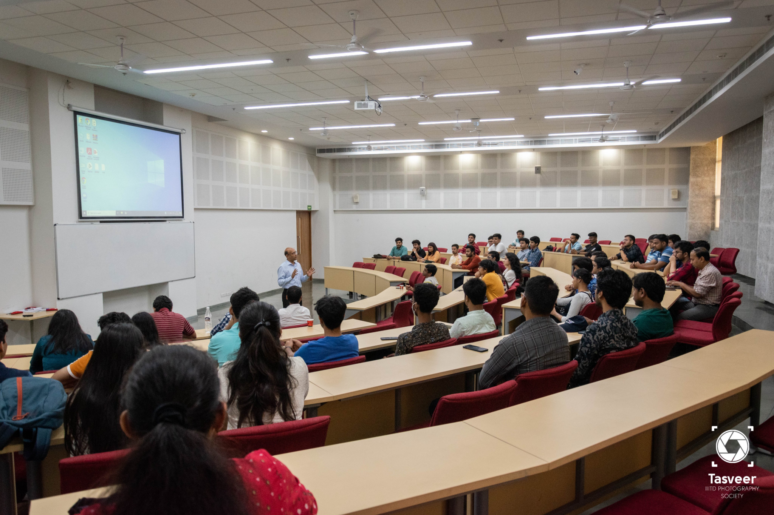
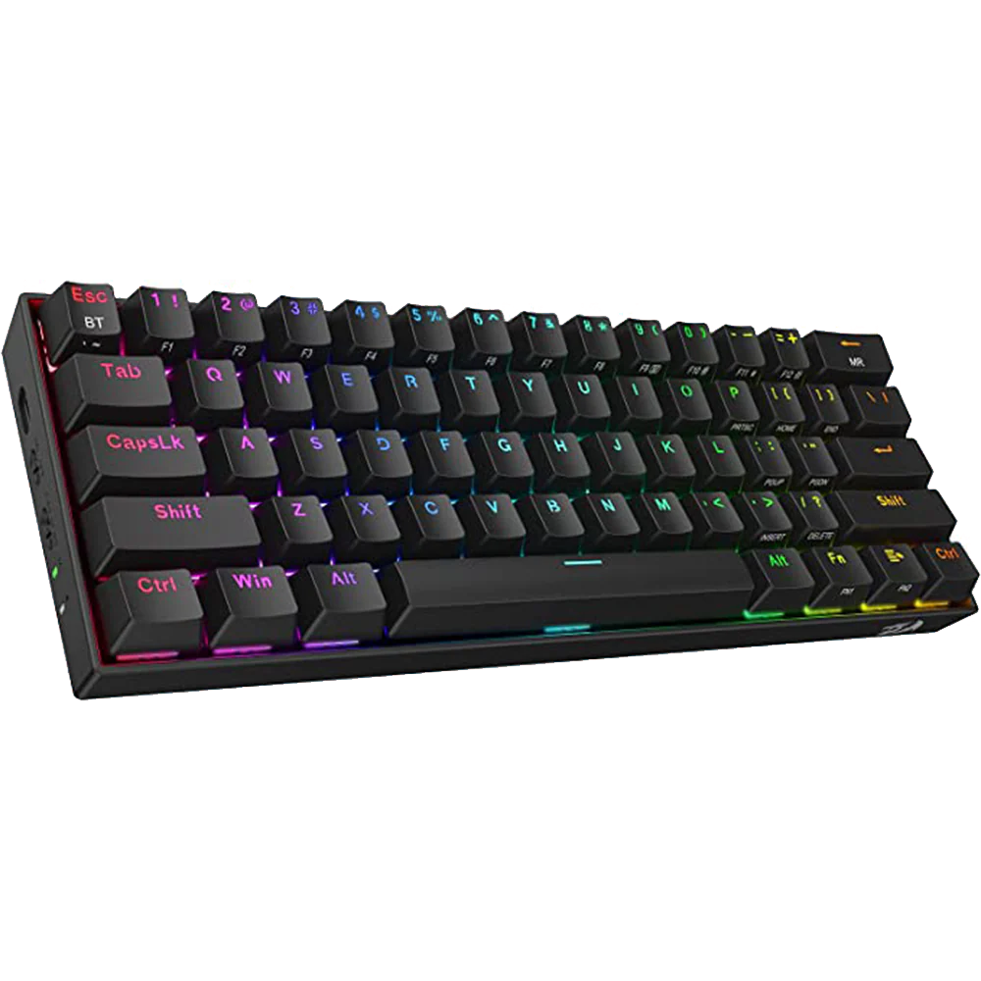
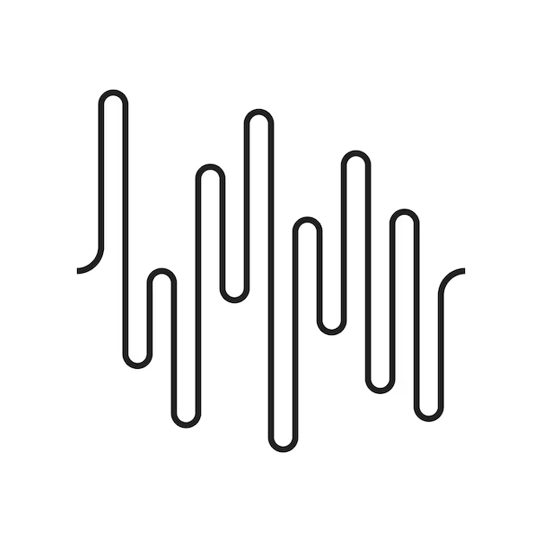
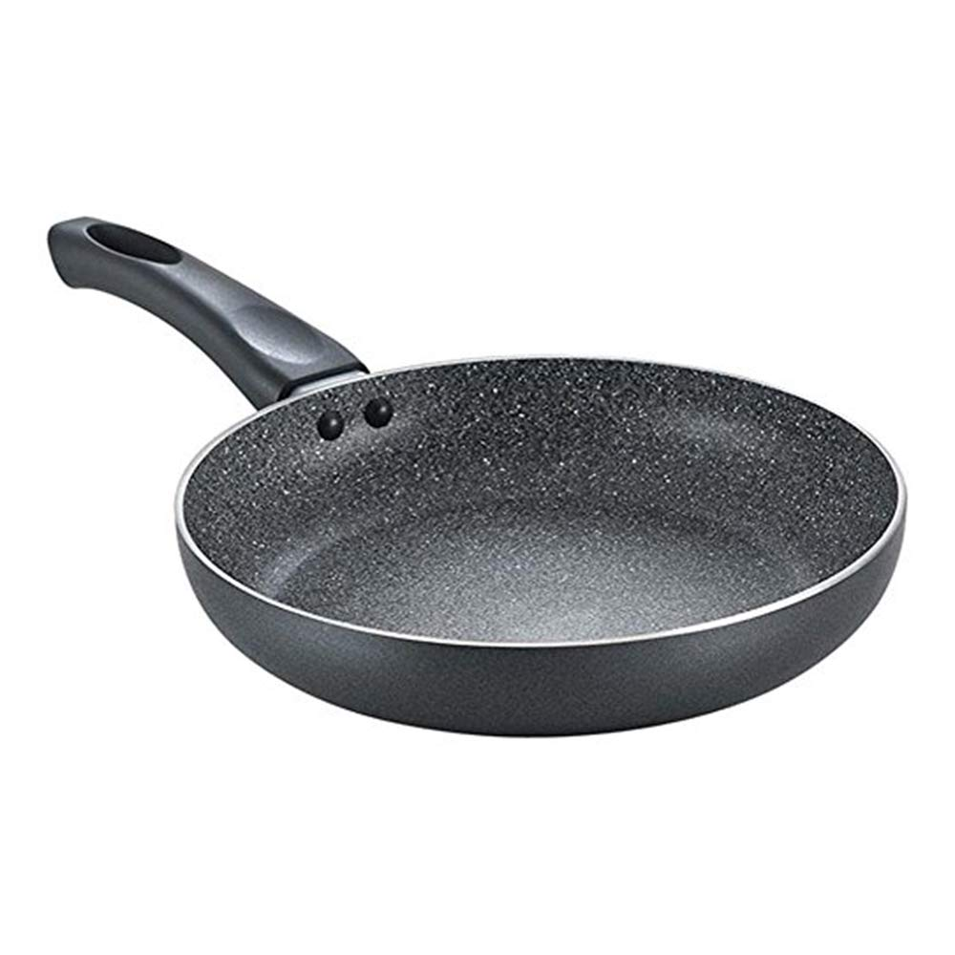
Captured Soundscapes
Siddhant Bali 2022496
Assignment 1 DES 514 DAVPW

Slide 2

Noise : Classroom
8000 Hz
16000 Hz
44100 Hz
I recorded this during a regular class session with students talking and moving around
The sound jumps between quiet moments and sudden loud voices or chair scraping
Creates a busy, active learning atmosphere that feels familiar to anyone who's been to school
8000 Hz: Voices sound muffled like a phone call, hard to understand clearly
16000 Hz: Speech is clearer but still missing some crispness
44100 Hz: I can hear every paper rustle and footstep clearly

Slide 3
Silence: Library
8000 Hz
16000 Hz
44100 Hz
Recorded in the quiet study area where people whisper and try not to make noise
It's never completely silent - I can hear air conditioning, distant footsteps, pages turning
Creates a peaceful, focused mood that makes you want to concentrate
8000 Hz: Loses some of the subtle background details but main quietness remains
16000 Hz: Captures most of the quiet ambient sounds well
44100 Hz: I could pick up tiny sounds like someone's jacket moving

Slide 4
Rumbling: Metro
8000 Hz
16000 Hz
44100 Hz
Captured this while riding the metro - the train wheels on tracks create deep vibrations
The sound is constant and powerful, you can feel it in your chest
Makes you feel the energy of city transportation and urban life
8000 Hz: Loses that deep, rumbling feeling completely, sounds thin and weak
16000 Hz: Gets some of the rumble but missing the powerful low end
44100 Hz: I get the full impact of those low frequencies that make metro rides feel powerful

Slide 5
Noise: Shower
8000 Hz
16000 Hz
44100 Hz
Recorded water hitting the shower walls and floor in my bathroom
It's like constant white noise that's actually quite relaxing
Creates a private, calming space where you can think or unwind
8000 Hz: Water loses its crisp, fresh sound, becomes dull
16000 Hz: Still sounds like water but not as bright and sparkly
44100 Hz: I can hear individual water droplets and the bathroom's echo

Slide 6
High Frequency: Ancient Brass Bowl Slap
8000 Hz
16000 Hz
44100 Hz
I hit an old brass singing bowl and recorded the ringing sound it makes
It starts with a sharp hit, then rings with beautiful high-pitched tones
Creates a spiritual, meditative feeling like you're in a temple
8000 Hz: Sounds completely dead and boring, loses all the magic
16000 Hz: Gets some of the ringing but cuts off the highest, most beautiful tones
44100 Hz: You get all those shimmering high notes that make it sound magical

Slide 7
Low Frequency: Fry Pan Sizzling
8000 Hz
16000 Hz
44100 Hz
Recorded a metal frying pan with very hot water poured into it, creating deep metallic tones and sizzling
The sound resonates with low, warm frequencies that you feel as much as hear, plus the sharp sizzle of water hitting hot metal
Reminds you of cooking and home, creates a cozy kitchen atmosphere with that familiar cooking sound
8000 Hz: Sounds okay since it's mostly low frequencies, but loses some of the water sizzle detail
16000 Hz: Captures the metallic tone and most of the sizzling sounds well
44100 Hz: Gets both the deep pan resonance and all the crisp water sizzling sounds

Slide 8
Ambience: Mechanical Keyboard Fast Strokes
8000 Hz
16000 Hz
44100 Hz
Recorded myself typing quickly on my mechanical keyboard
Each key makes a satisfying click sound, creating a rhythm of productivity
Sounds like focused work, coding, or writing - very modern and technical
8000 Hz: The clicks lose their sharp, satisfying quality, sound mushy
16000 Hz: Good click sounds but missing some of the crispness
44100 Hz: Each key press sounds crisp and distinct

Slide 9
What I Learned
Sound Type | 8kHz Quality | 16kHz Quality | 44.1kHz Quality
High frequency sounds (bowl, keyboard) | Poor | Okay | Excellent
Low frequency sounds (metro, pan) | Good | Good | Excellent
Mixed sounds (classroom, shower) | Okay | Good | Excellent
Quiet sounds (library) | Good | Good | Excellent
About the sounds:
Each location has its own sound personality - libraries feel calm, metros feel powerful
We're surrounded by human-made sounds in our daily lives
Some sounds help us focus (library quiet), others energize us (keyboard clicks)
About sample rates:
High-pitched sounds need high sample rates to sound good
Deep, rumbly sounds work fine at lower sample rates
The singing bowl was the biggest victim of low sample rates
44.1kHz captures everything properly, like our ears actually hear it

Slide 10
Thank You
Siddhant Bali 2022496
Assignment 1 DES 514 DAVPW
“Higher frequencies need higher sample rates to sound good!”
:)

